Slide 1


St. MARTIN’S ENGINEERING COLLEGE
UGC Autonomous
NBA & NAAC A+ ACCREDITED
Dhulapally, Secunderabad– 500100
Department of Computer Science and Engineering
A Recurrent CNN for Automatic Detection and Classification of Coronary Artery Plaque and Stenosis in Coronary CT Angiography
Batch No: 17
1. Mr. Bhupendra Kumar (19K81A05C4)
2. Mr. Mohammed Anwar (19K81A05F8)
3. Mr. Sagar Sharma (19K81A05G7)
Under the Guidance of
Mrs. E. Soumya
Associate Professor
Department of Computer Science and Engineering

Slide 2
OUTLINE
Abstract
Overall Design
Experimental Results
Performance Evaluation
Conclusion And Future Enhancement
References
100 % of Code/ Project Implementation - DEMO

Slide 3
ABSTRACT
Various types of atherosclerotic plaque and varying grades of stenosis could lead to different management of patients with coronary artery disease. Therefore, it is crucial to detect and classify the type of coronary artery plaque, as well as to detect and determine the degree of coronary artery stenosis.
To define the reference standard, the presence and the type of plaque in the coronary arteries as well as the presence and the anatomical significance of coronary stenosis were manually annotated in the MPR images by identifying the start- and end-points of the segment of the artery affected by the plaque.
First, a 3D convolutional neural network is utilized to extract features along the coronary artery. Subsequently, the extracted features are aggregated by a recurrent neural network that performs two simultaneous multiclass classification tasks.
First task, to detect type of coronary artery plaque. Second task, to detect significance of stenosis.

Slide 4
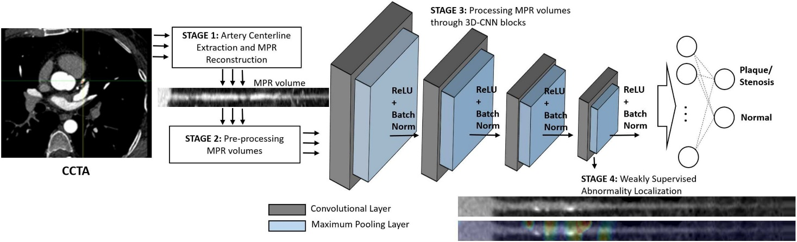
OVERALL DESIGN

Slide 5
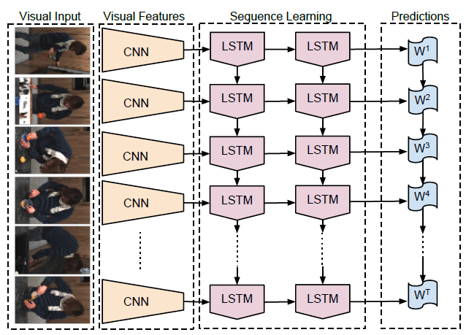
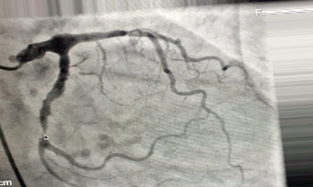

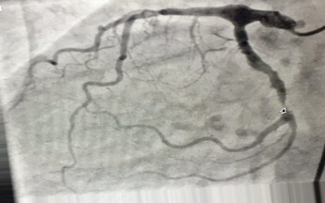


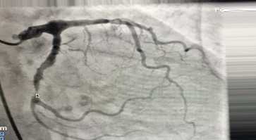
OVERALL DESIGN

Slide 6
EXPERIMENTAL RESULTS
From the available dataset consisting of 163 patients, CCTA scans of 81 (50%) and 17 (10%) patients were randomly chosen for training and validation, respectively. The scans of the remaining 65 (40%) patients were used for testing the method.
To assess the performance of the proposed RCNN for plaque detection and characterization we first evaluated the performance for each annotated segment
To assess the performance of the proposed RCNN for detection and determination of the anatomical significance of stenosis, we analyzed the results achieved on the segment-, artery- and patient-levels.
An additional experiment was performed in which a network with an identical CNN architecture was utilized, while the RNN was replaced by fully connected (FC) layers.
To analyze different sequence lengths and to aggregate the features extracted by the CNN into one vector, a global max pooling layer was employed after the CNN.
This layer was subsequently connected to two FC layers instead of the GRUs.

Slide 7
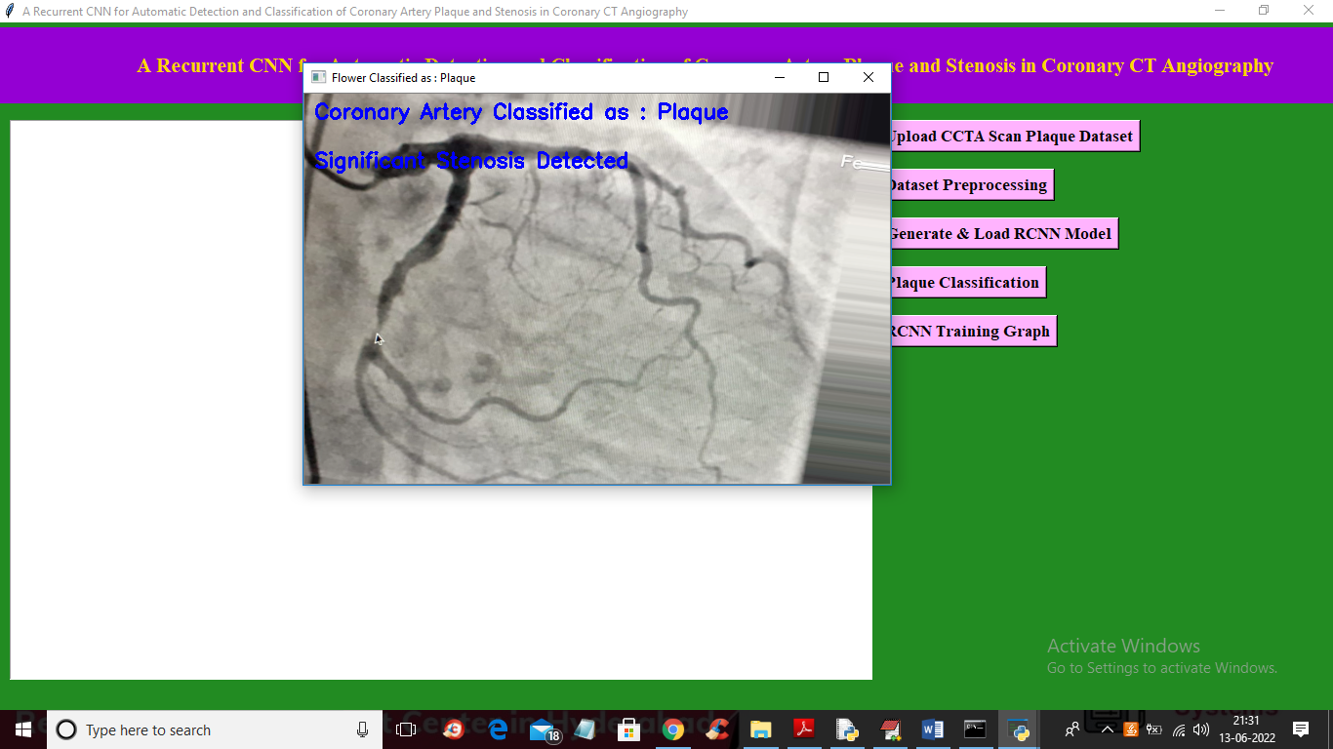
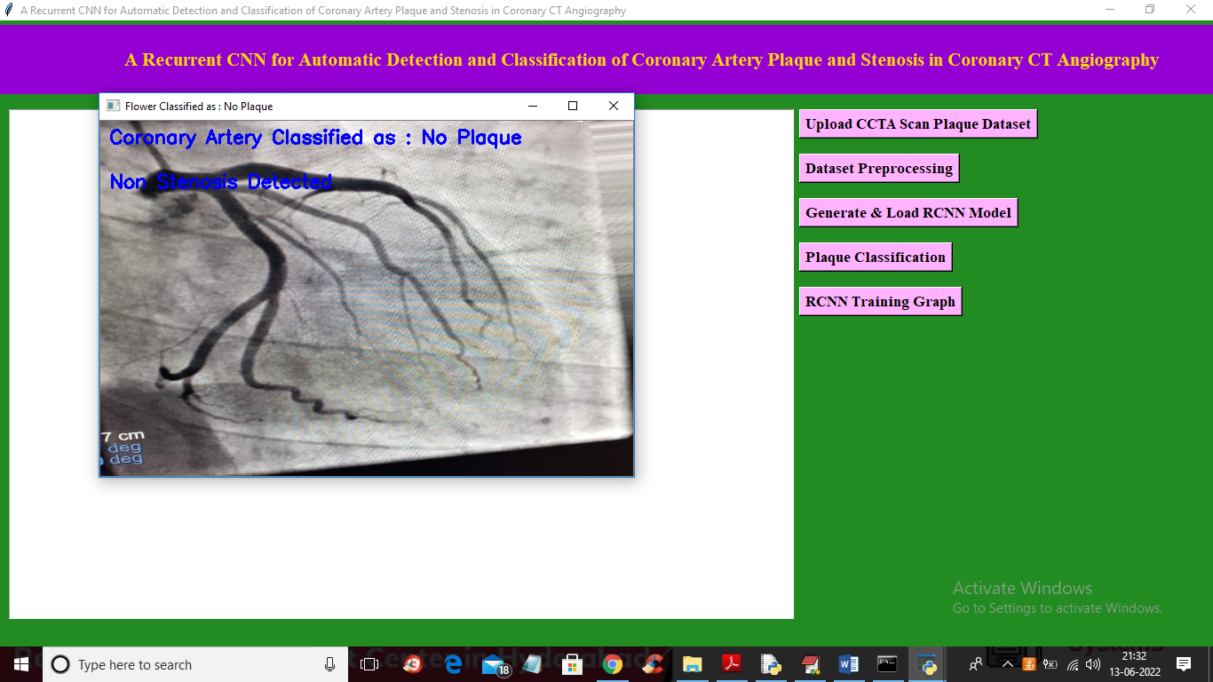
EXPERIMENTAL RESULTS
CLASSIFIED AS PLAQUE
CLASSIFIED AS NO PLAQUE

Slide 8
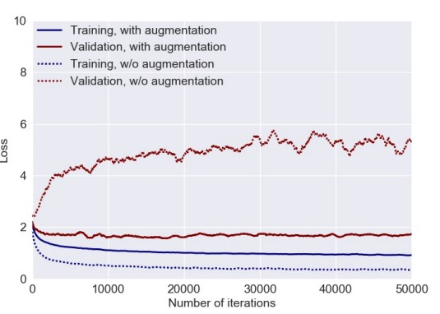
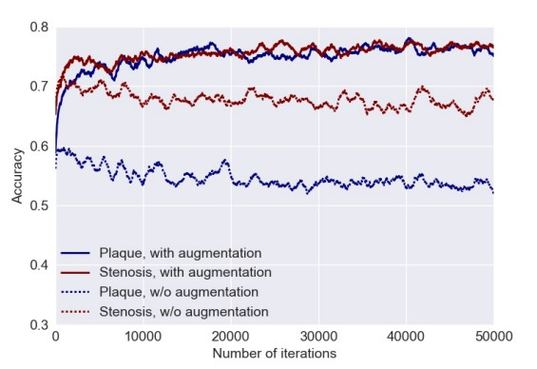
PERFORMANCE EVALUATION
Significance of coronary artery stenosis during training with and without data augmentation.
Training and validation losses during training with and without data augmentation

Slide 9
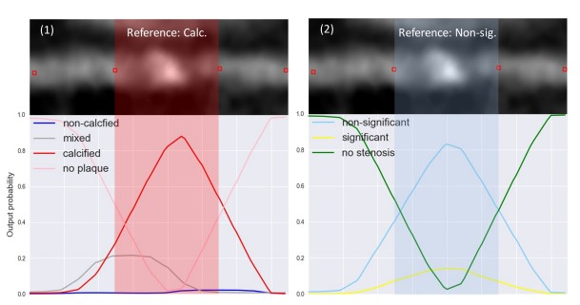
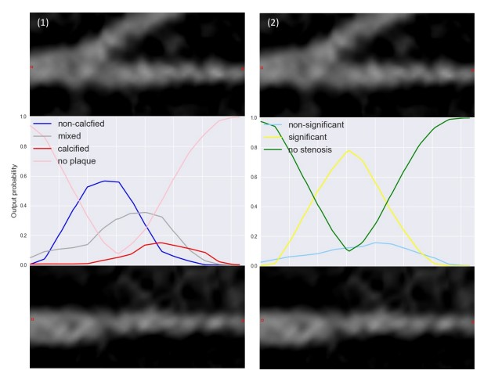
PERFORMANCE EVALUATION
Plaque indicated by its manually annotated boundaries and the reference labels
Plaque and stenosis classification over a bifurcation of artery in MPR view and 90 degree rotated view.

Slide 10
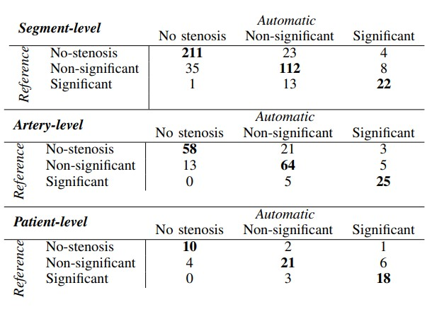
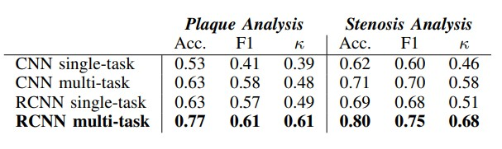
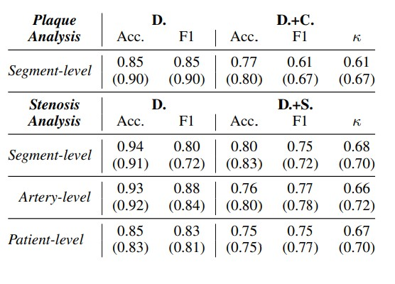
PERFORMANCE EVALUATION
Comparison of different networks used.
Confusion matrix output for segment, artery and patient levels.
ANALYSIS OF PLAQUE, THE PERFORMANCE FOR DETECTION OF PLAQUE (D.). DETECTION AND CHARACTERIZATION OF PLAQUE (D.+C.) . DETECTION AND CLASSIFICATION OF THE ANATOMICAL SIGNIFICANCE OF THE STENOSIS (D.+S.)

Slide 11
CONCLUSION
A method for automatic detection and characterization of the coronary artery plaque type, as well as detection and characterization of the anatomical significance of the coronary artery stenosis was presented.
The method employs an RCNN that analyses an MPR view of a coronary artery extracted from a CCTA scan using the coronary artery centreline. The RCNN utilizes a 3D CNN that computes image features from 3D volumes extracted along the coronary artery centreline.
Subsequently, an RNN analyses the computed image features to perform both classification tasks. Unlike most previous methods that detect and characterize coronary artery plaque and stenosis relying on the coronary artery lumen segmentation.
The proposed method requires only the coronary artery centreline as an input along with the CCTA image.

Slide 12
FUTURE ENHANCEMENT
Unlike most previous methods that detect and characterize coronary artery plaque and stenosis relying on the coronary artery lumen segmentation, RNN and RCNN can be used in future enhancement of this automation and can be implemented for both classification of coronary artery and detecting significance of stenosis in coronary artery as the present method requires only the coronary artery centreline as an input along with the CCTA image.

Slide 13
REFERENCES
[1]. W. Xue, G. Brahm, S. Pandey, S. Leung, and S. Li, “Full left ventricle quantification via deep multitask relationships learning,” Medical image analysis, vol. 43, pp. 54–65, 2018.
[2]. D. Mozaffarian, E. J. Benjamin, A. S. Go, D. K. Arnett, M. J. Blaha, M. Cushman, S. R. Das, S. de Ferranti, J.-P. Després, H. J. Fullerton et al., “Heart disease and stroke statistics - 2016 update,” Circulation, vol. 133, no. 4, pp. e38–e360, 2016.
[3] S. Sankaran, M. Schaap, S. C. Hunley, J. K. Min, C. A. Taylor, and L. Grady, “Hale: Healthy area of lumen estimation for vessel stenosis quantification,” in International Conference on Medical Image Computing and Computer-Assisted Intervention. Springer, 2016, pp. 380–387.
[4]. M. Liang and X. Hu, “Recurrent convolutional neural network for object recognition,” in Proceedings of the IEEE Conference on Computer Vision and Pattern Recognition, 2015, pp. 3367–3375.
[5]. A. Karpathy and L. Fei-Fei, “Deep visual-semantic alignments for generating image descriptions,” in Proceedings of the IEEE Conference on Computer Vision and Pattern Recognition, 2015, pp. 3128–3137.
[6]. D. Dey, T. Schepis, M. Marwan, P. J. Slomka, D. S. Berman, and S. Achenbach, “Automated three-dimensional quantification of noncalcified coronary plaque from coronary CT angiography: comparison with intravascular US,” Radiology, vol. 257, no. 2, pp. 516–522, 2011.

Slide 14
REFERENCES
[7]. A. Arbab-Zadeh and J. Hoe, “Quantification of coronary arterial stenosis by multidetector CT angiography in comparison with conventional angiography: methods, caveats, and implications,” JACC: Cardiovascular Imaging, vol. 4, no. 2, pp. 191–202, 2010.
[8]. K. Cho, B. Van Merriënboer, C. Gulcehre, D. Bahdanau, F. Bougares, H. Schwenk, and Y. Bengio, “Learning phrase representations using rnn encoder-decoder for statistical machine translation,” arXiv preprint arXiv:1406.1078, 2009.
[9]. L. Antiga and D. A. Steinman, “Robust and objective decomposition and mapping of bifurcating vessels,” IEEE Transactions on Medical Imaging, vol. 23, no. 6, pp. 704–713, 2008.
[10]. M. J. Budoff, D. Dowe, J. G. Jollis, M. Gitter, J. Sutherland, E. Halamert, M. Scherer, R. Bellinger, A. Martin, R. Benton et al., “Diagnostic performance of 64-multidetector row coronary computed tomographic angiography for evaluation of coronary artery stenosis in individuals without known coronary artery disease: results from the prospective multicenter ACCURACY trial,” Journal of the American College of Cardiology, vol. 52, no. 21, pp. 1724–1732, 2004.

Slide 15
CONTRIBUTION
BATCH C17
ROLL NUMBER | NAME | CONTRIBUTION
19K81A05C4 | BHUPENDRA KUMAR | TRAINED CNN MODEL
19K81A05F8 | MD. ANWAR | GUI DEPLOYMENT
19K81A05G7 | SAGAR SHARMA | PERFORMANCE EVALUATION AND TRAINING GRAPH

Slide 16
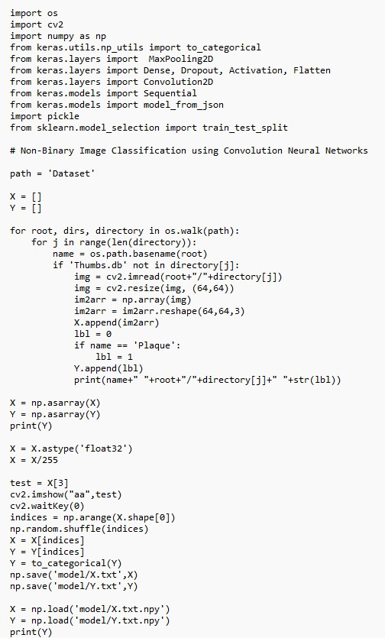
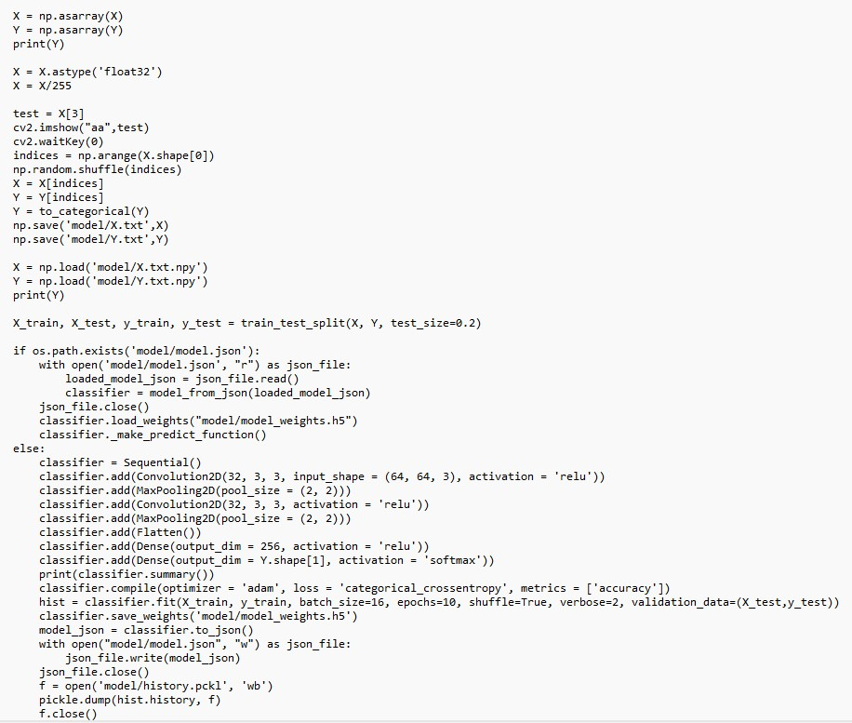
IMPLEMENTATION OF CODE/ DEMO

Slide 17
QUERIES ??

Slide 18
THANK YOU

